Slide 1


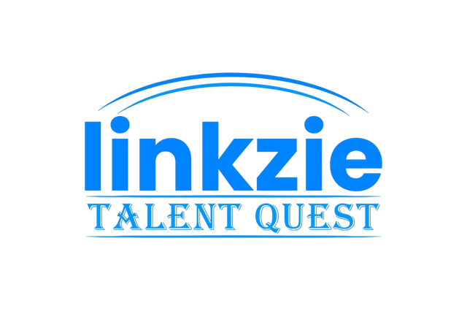






Idea submission

Slide 2


Team details
Team Lead:
Name : Shrihari Viswanathan
Contact: 8147635705
Email:shrihariviswanathan.cs24@bmsce.ac.in
Team Member 2:
Name : Soham Kulkarni
Contact: 8147006674
Email:sohamkulkarni.cs24@bmsce.ac.in
Team Member 3:
Name : Sohan BC
Contact:9986047566
Email : sohanbc.cs24@bmsce.ac.in

Slide 3


Our solution
Automated Templates – AI fills structured report formats.
Data Insights & Analytics – Extracts patterns & trends.
Conversational Reports – Generates reports via chatbot interaction.
AI Summarization – Condenses lengthy data/documents.
Natural Language Processing (NLP) – Enhances readability & coherence.
Customizable & Scalable – Adapts to business needs.
Integration Capabilities – Works with CRM, ERP, and BI tools.

Slide 4

TECHNICAL APPROACH
Tkinter
Gemini 1.5 pro
Os
dotenv

Slide 5
Workflow/pipeline
1. Setup and Initialization
Load Environment Variables: Loads API key from .env using dotenv.
Configure Generative AI Model: Set parameters like temperature, token limit, and stop sequences.
2. GUI Initialization (Tkinter)
Window Setup: Full-screen Tkinter window.
Style & Widgets: Styled with ttk (themed Tkinter) - question prompt, input field, history frame.
3. User Interaction Loop
Bot's Initial Prompt: Displays “Hi, how can I help you?”
User Input: User types a response and submits via Submit Button or Enter key.

Slide 6
Workflow/pipeline
4. Processing User Input
Validate & Update History: Ensure valid input and display in history box.
AI Response: Send input to Google Gemini AI, get response, and display it.
5. Continuous Interaction
Loop: Ongoing conversation, context maintained using conversation history.
Exit: User exits full-screen with Escape key.
6. Finalization
End: The conversation ends when the user exits the app or stops interacting.

Slide 7
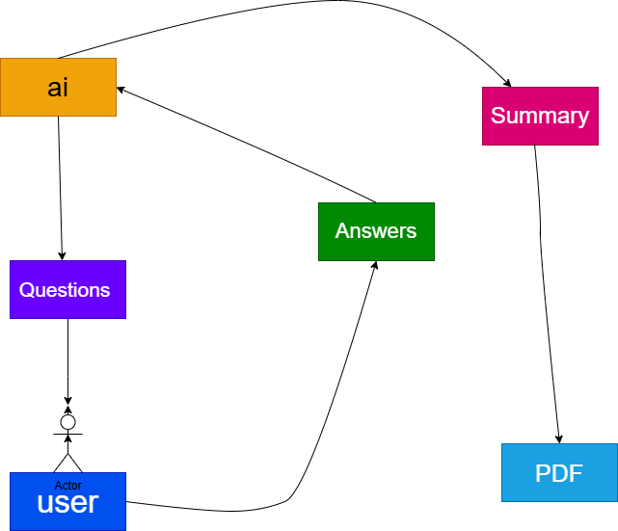
Workflow/pipeline

Slide 8
Feasibility & FUTURE SCOPE
Feasibility:
Technological Readiness – AI models (GPT, BERT) can generate high-quality reports.
Integration with Business Tools – Can connect with CRM, ERP, and BI systems.
Customization & Automation – Supports various industries (Finance, Healthcare, HR, etc.).
Cost Efficiency – Reduces manual effort, saving time and operational costs.
Accuracy & Consistency – AI ensures uniform reporting with data-driven insights.

Slide 9
Feasibility & FUTURE SCOPE
Future Scope:
Advanced AI Understanding – Improved NLP for deeper context awareness.
Real-Time Report Generation – AI-based live dashboards and automated insights.
Multimodal Reports – Integrating text, visuals, and voice-based reporting.
AI-Powered Decision Making – AI-generated recommendations based on reports.
Personalized & Adaptive Reports – AI-tailored reports based on user preferences.
Secure & Compliant Reporting – AI ensuring compliance with industry standards.
AI & Blockchain Integration – Enhanced data security and auditability.

